Slide 1
St. Louis District Biological Opinion RRAT
Notes:
Introduce self.
Thank you for the opportunity to talk to you today about Low Water Reference Plane.

Slide 2
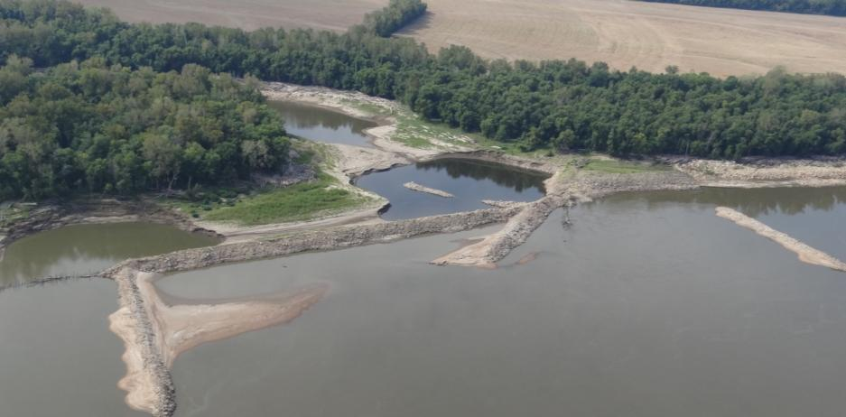
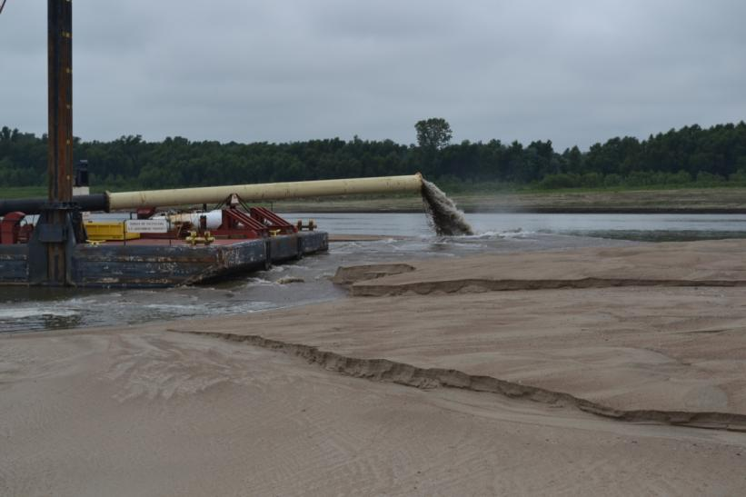
FY 14 RRAT– Biological Opinion
SCED – 3 phases of construction, final phase awarded in FY14. First two phases complete
Increase flow down Establishment Chute RM 132
FY13 efforts include flexible Dredge Pipe – Manskers RM 104
Created an ephemeral island with 400,000 cy of dredge material
Identifying FY14 sites for island development
FY14 efforts were not executed due to high water

Slide 3
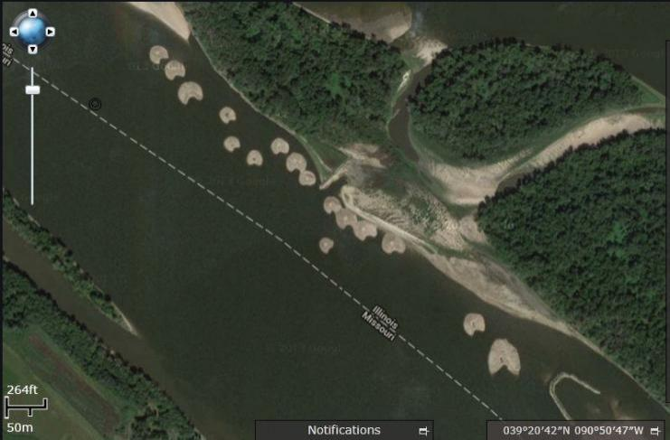
Bi-Op Flexible Dredge Pipe and Spill Barge
River Mile 221
2,400 feet of flexible dredge pipe purchased in early 2000’s
Flexible dredge spill barge “Thomas George” completed in FY14
Create ephemeral islands with dredge spoil to enhance environmental diversity
River Mile 270

